Slide 1
haunting exo-planets using machine learning with nasa’s dataset
Made by vamsi krishna

Slide 2

ACKNOWLEDGEMENT
I would like to acknowledge nasa.gov
The dataset which is provided by nasa is the heart for my project.

Slide 3
What are exo-planets
An exoplanet is any planet beyond our solar system. Most orbit other stars, but free-floating exoplanets, called rogue planets, orbit the galactic center and are untethered to any star.
Most of the exoplanets discovered so far are in a relatively small region of our galaxy, the Milky Way. We know from NASA’s Kepler Space Telescope that there are more planets than stars in the galaxy.
By measuring exoplanets’ sizes (diameters) and masses (weights), we can see compositions ranging from very rocky (like Earth and Venus) to very gas-rich (like Jupiter and Saturn). Exoplanets are made up of elements similar to those of the planets in our solar system, but their mixes of those elements may differ. Some planets may be dominated by water or ice, while others are dominated by iron or carbon. We’ve identified lava worlds covered in molten seas, puffy planets the density of Styrofoam and dense cores of planets still orbiting their stars.

Slide 4
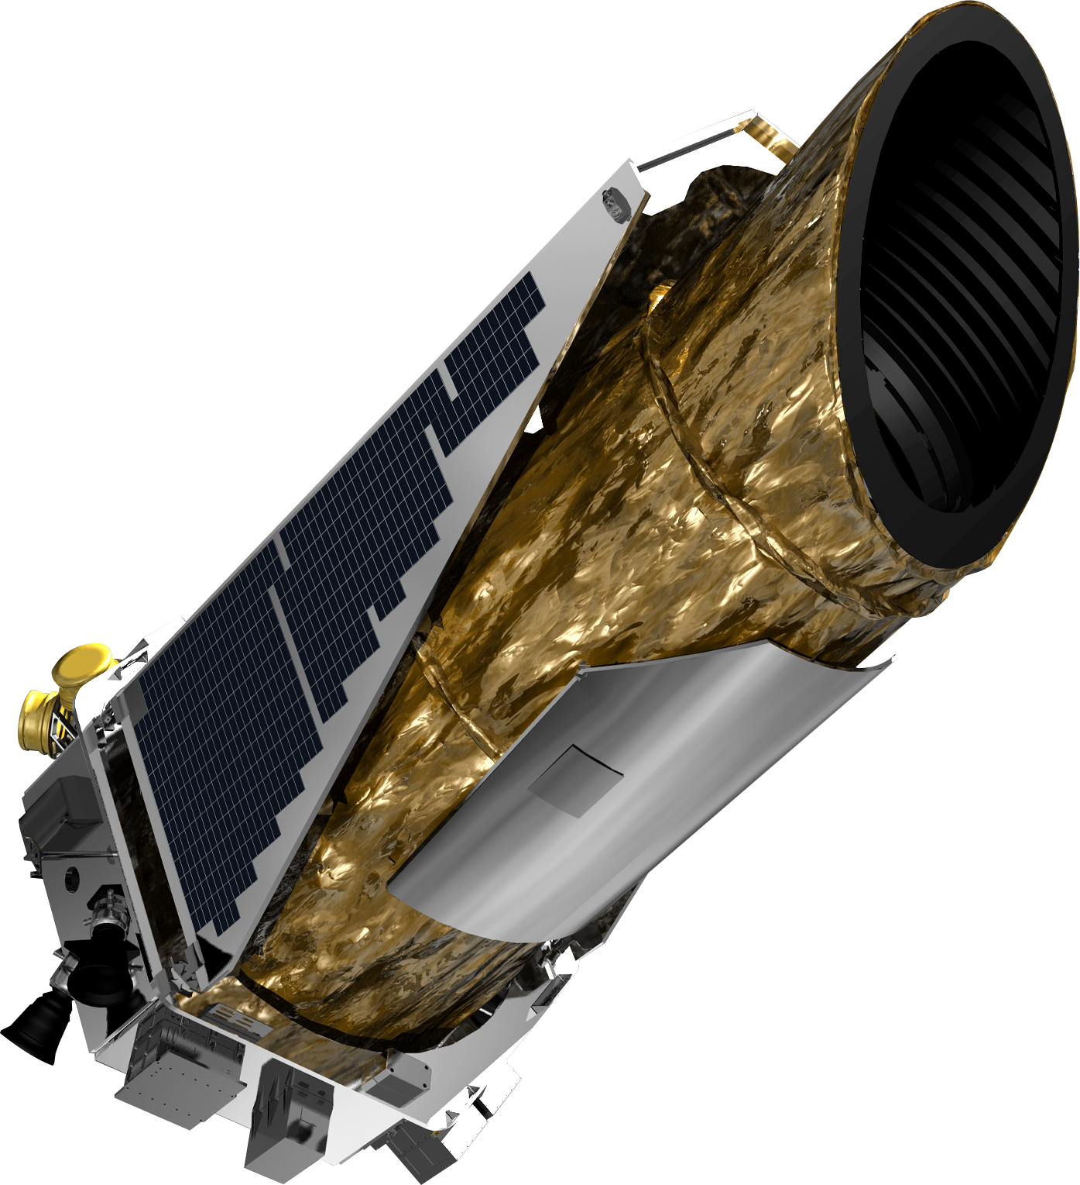
Nasa’s kepler telescope
The Kepler space telescope is specifically designed to survey our region of the Milky Way galaxy to discover hundreds of Earth-size and smaller planets in or near the habitable zone and determine the fraction of the hundreds of billions of stars in our galaxy that might have such planets.

Slide 6
Why machine learning to haunt exoplanets
Machine learning has proven many solutions for world class problems in science it can even helps use to haunt exo-planets.
Machine learning finds out the accuracy for all predections which we make using dataset.

Slide 7
haunting exo-planets using machine learning
The steps involved in this project are as follows:
Examining data
Classifying models
Conclusion &further work

Slide 8
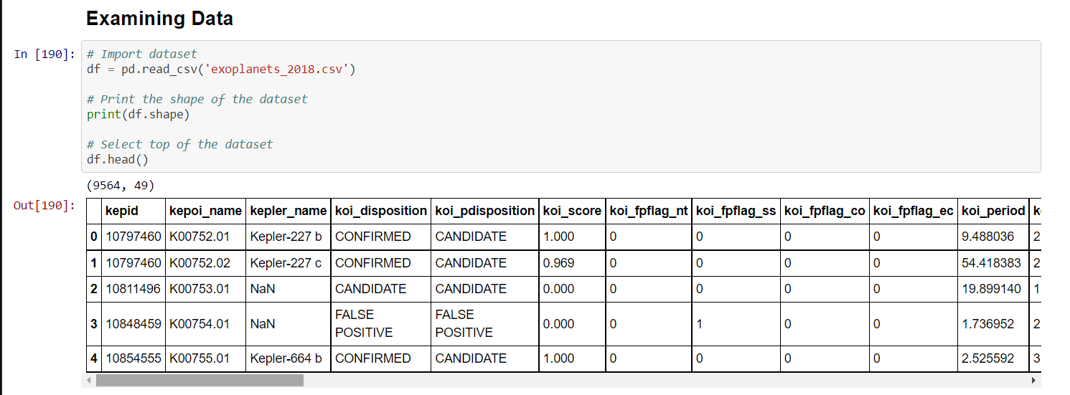
Examining data I just examined data by importing dataset

Slide 9
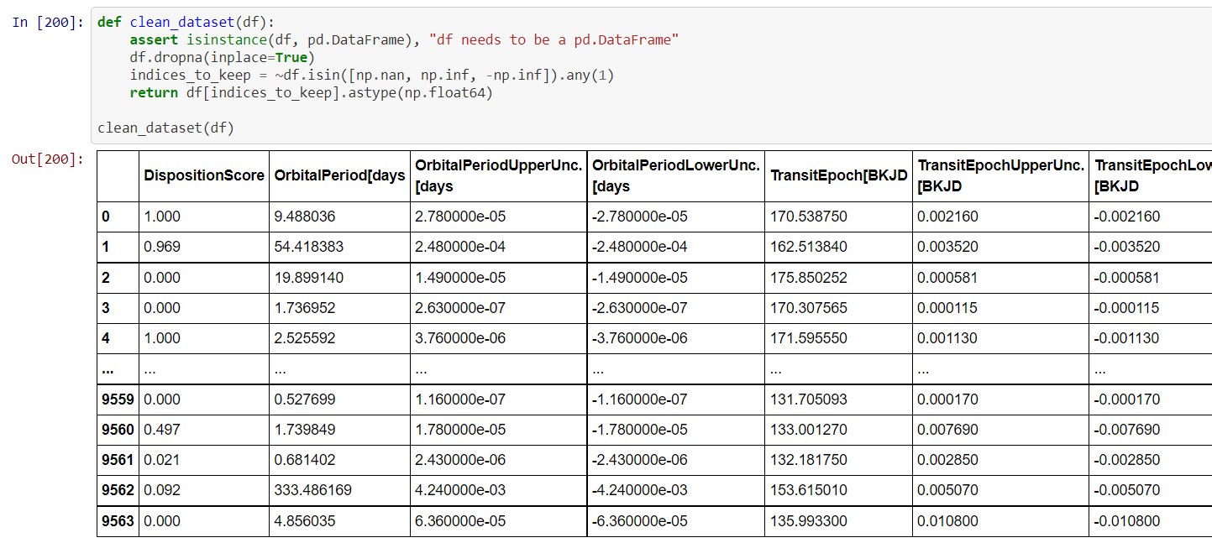

Slide 10
Classifying models
I used 3 models in this project they are as follows
Logistic regression model
Kneighboursclassifier
Instantiate model
We need to train each model and we need to choose the final output as result for our project.

Slide 11
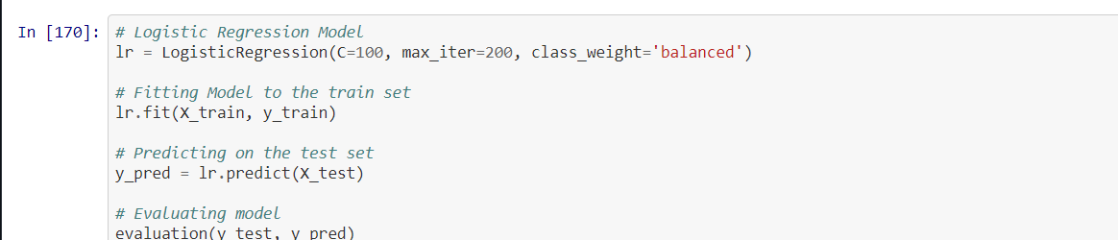
1.Logistic regression model

Slide 12
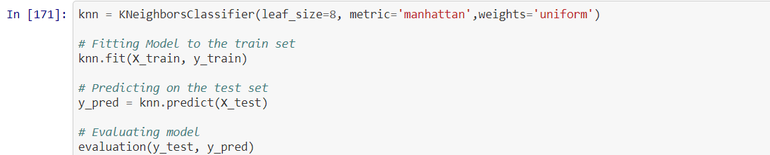
2.kneighboursclassifer

Slide 13
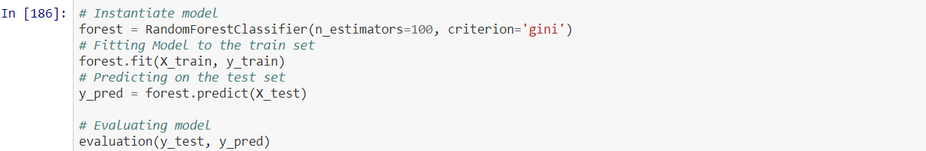
3.Instantiate model

Slide 14
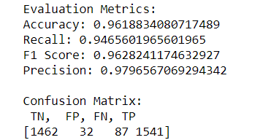
Final output

Slide 15
Conclusion and further work
The best result that I got by defined models is approximately 96% for test accuracy.
I could say M.L models are so good at the hunt for exoplanets.
As further works:
I am planning to include TESS data in the project.
Visual recognition and neural model could be added to project.

Slide 16

Project made by
VAMSI KRISHNA

